Slide 1
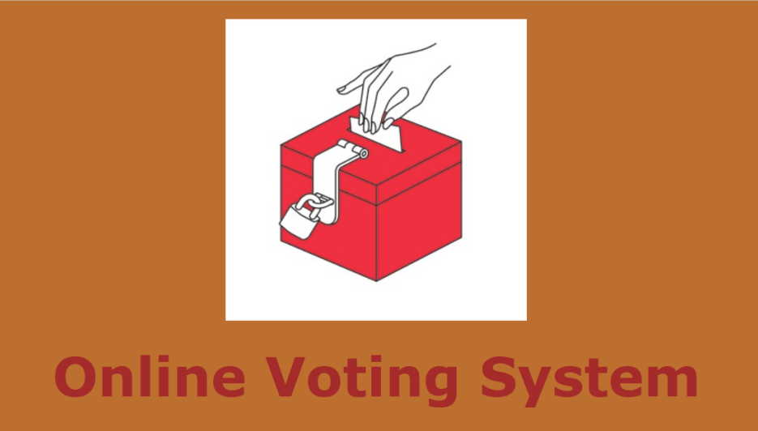
Online Voting System
Nireeksha(01FB17ECS721)
Neha B Garg(01FB16ECS224)
Komala V(01FB17ECS716)

Slide 2
Contents:
Introduction
Tools
Modules
Future Enhancement

Slide 3
Introduction
It is a electronic voting.
It is a remote e-voting via the internet. So also called as i-voting.
E-voting provides full-function online voting.

Slide 4
tools:
Languages
HTML
Php
Database
Mysql
Server
XAmpp

Slide 5
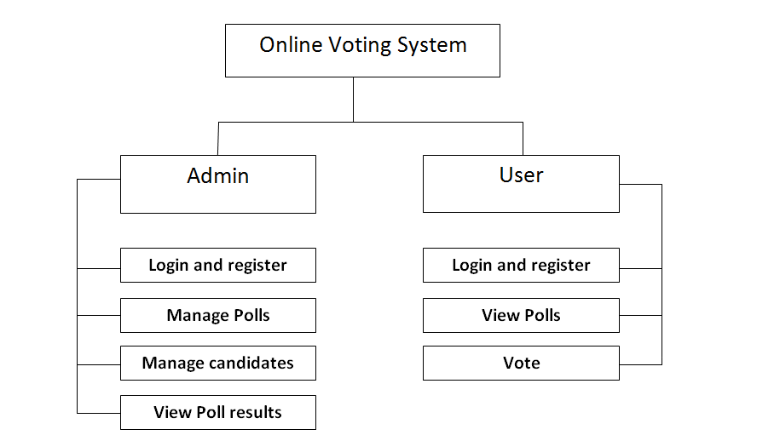
Modules:

Slide 6
Admin
Admin monitors the whole online voting system.
Can add new admins.
Check poll results.
User(voter)
User can view the polls and vote for any candidate.
Can update user profile.

Slide 7
Future Enhancement
Adding the Biometric security.
Making it an complete mobile application.
Bringing up the whole voting process to online.
Providing more security using OTP and mobile notifications.
Integrating social network service.

Slide 8
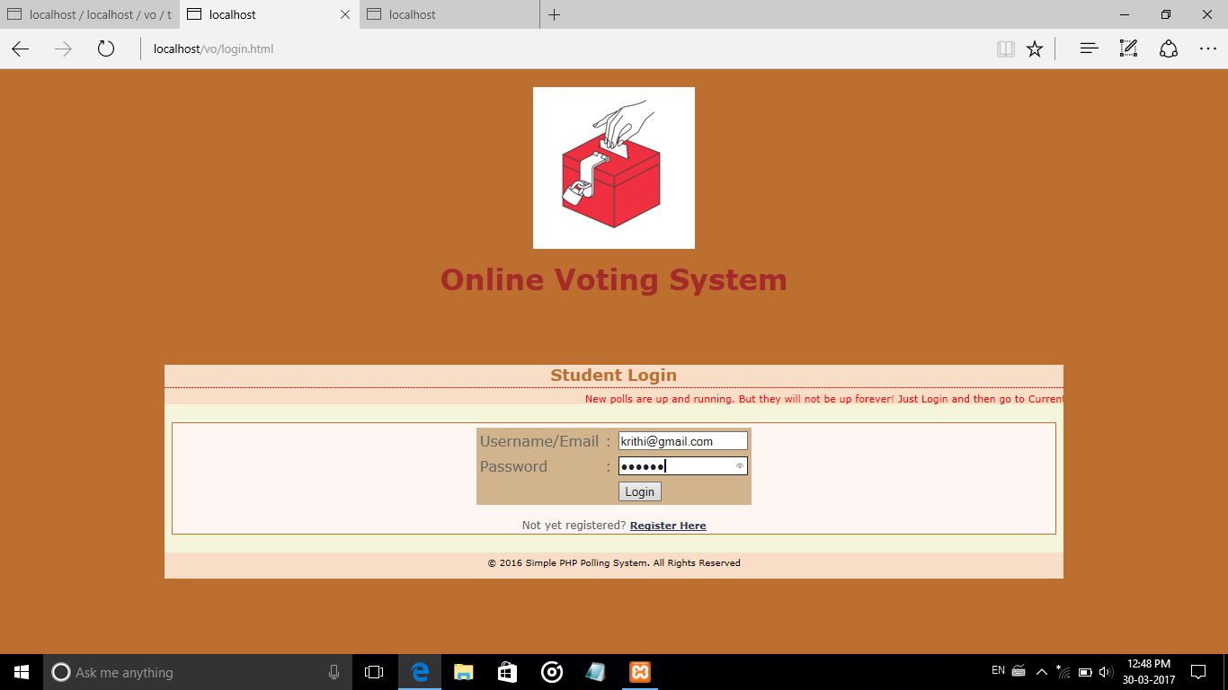
Screenshots

Slide 9
Thank you..!!

